Slide 1

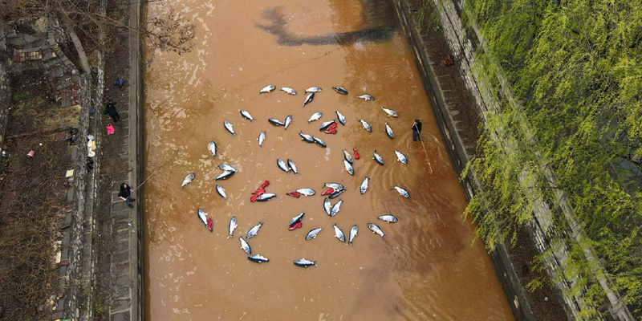




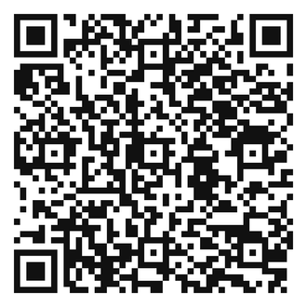

Environmental and Social Sustainability
Grant Program
Food Desert Engagement
Do you have an idea that:
Pollution Awareness Art
  Enhances the environment in CT?
  Engages people in sustainability?
  Uses education, research or community building?
  Addresses social challenges?
Projects must target one or more of UConn's strategic sustainability areas
Receive up to
AND related social challenges
  Including diverse perspectives
  Addressing systemic inequalities
  Environmental justice
  Community development
  Social/health inequity
Apply by 4.7

Slide 2
Environmental and Social Sustainability
Grant Program
Do you have an idea that:
Projects must target one or more of UConn's strategic sustainability areas
AND related social challenges
  Enhances the environment in CT?
  Engages people in sustainability?
  Uses education, research or community building?
  Addresses social challenges?
  Including diverse perspectives
  Addressing systemic inequalities
  Environmental justice
  Community development
  Social/health inequity
Receive up to
Apply by 4.7

